Slide 1
Cassandra
Lecturer: Ngo Huy Bien
Software Engineering Department
Faculty of Information Technology
VNUHCM - University of Science
Ho Chi Minh City, Vietnam
nhbien@fit.hcmus.edu.vn

Slide 2

Objectives

Slide 3

References
Jeff Carpenter and Eben Hewitt (2020). Cassandra - The Definitive Guide - Distributed Data at Web Scale. O'Reilly Media.

Slide 4
The Cassandra Elevator Pitch [1]
Apache Cassandra is an open source, distributed, decentralized, elastically scalable, highly available, fault-tolerant, tuneably consistent, row-oriented database.
Cassandra bases its distribution design on Amazon’s Dynamo and its data model on Google’s Bigtable, with a query language similar to SQL.
Created at Facebook, it now powers cloud-scale applications across many industries.

Slide 5
Install Prerequisites
Check prerequisites
https://cassandra.apache.org/doc/latest/getting_started/installing.html#prerequisites
Install Oracle Java Standard Edition 8
sudo apt-get install openjdk-8-jdk
java -version //Output: openjdk version "1.8.0_292"
Install Python 3.6.9
python --version

Slide 6
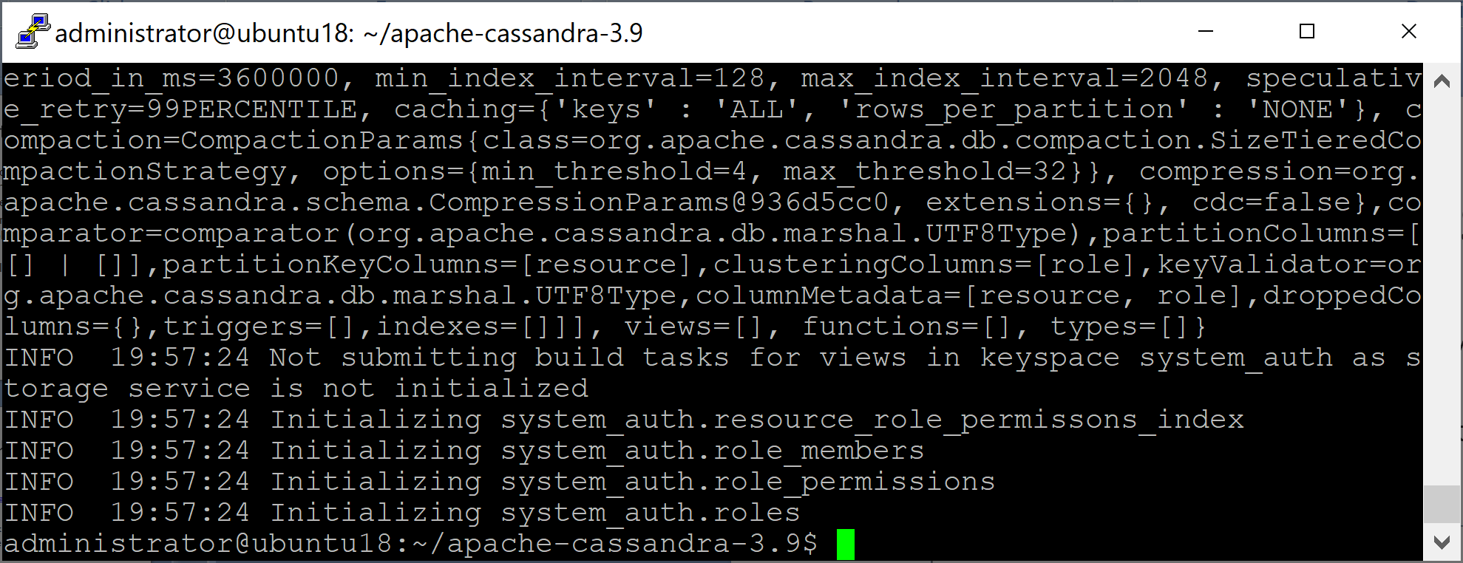
Download and Run Cassandra
curl -OL http://archive.apache.org/dist/cassandra/3.9/apache-cassandra-3.9-bin.tar.gz
tar xzvf apache-cassandra-3.9-bin.tar.gz
cd apache-cassandra-3.9
bin/cassandra

Slide 7
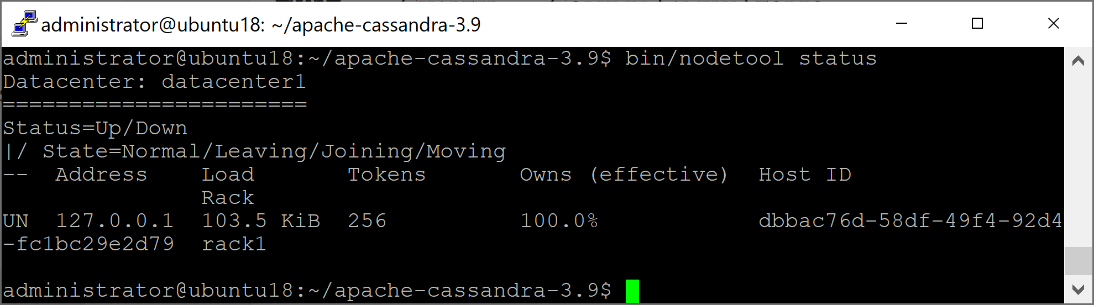
Verify Status
bin/nodetool status

Slide 8
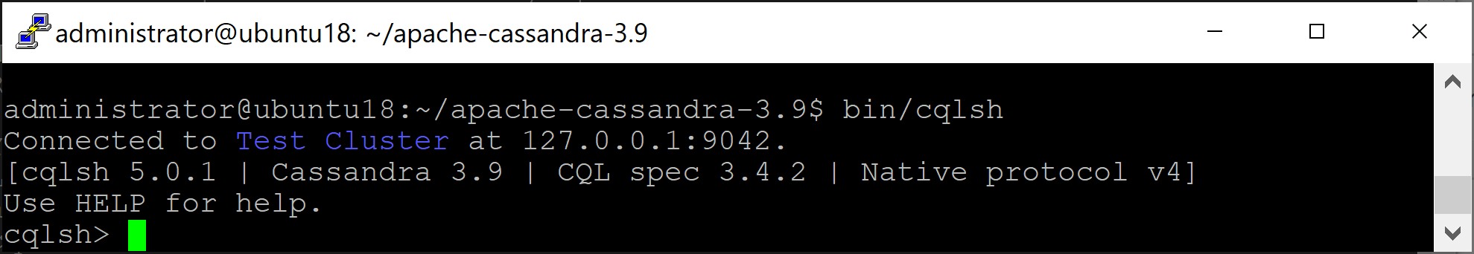
Run the CQL Shell
cqlsh
cqlsh localhost 9042
cqlsh> HELP

Slide 9
Create a Keyspace and Table
A Cassandra keyspace is sort of like a relational database.
CREATE KEYSPACE my_keyspace WITH replication = {'class':'SimpleStrategy', 'replication_factor': 1};
DESCRIBE KEYSPACE my_keyspace;
USE my_keyspace;
CREATE TABLE user ( first_name text,
last_name text, PRIMARY KEY (first_name));
DESCRIBE TABLE user;

Slide 10
Write and Read Data
INSERT INTO user (first_name, last_name ) VALUES ('Bill', 'Nguyen');
SELECT COUNT (*) FROM user;
SELECT * FROM user WHERE first_name='Bill';
DELETE last_name FROM USER WHERE first_name='Bill';
SELECT * FROM user WHERE first_name='Bill';
DELETE FROM USER WHERE first_name='Bill';
TRUNCATE user;
DROP TABLE user;

Slide 11


Slide 12
Architecture in brief
https://docs.datastax.com/en/archived/cassandra/3.0/cassandra/architecture/archIntro.html

Slide 13

Thank You & See You Again

